Slide 1
New ECE Curriculum Summary
10/7/13

Slide 2
Implementation Schedule
Now: Final documentation for COE, UUCC
  New course form, curriculum description
Now: Offer second pilot of Biomedical Circuits and Signals
Spring: Offer pilot of Enabling Robotics
Fall 14: Launch new curriculum with the two sophomore courses.
Spring 15: Begin offering the new fundamentals courses.

Slide 3
Background/Broad Motivation
Students want flexibility/global opportunities.
  Study abroad.
  Alternative semesters of research or service learning.
Engineers are far more interdisciplinary.
  Interdisciplinary/Combine with other disciplines - minors.
  Other disciplines study engineering – minors.
  Transition to learn how to learn balanced with a particular body of knowledge.
ECE as a discipline is broader than ever.
(Sources: NAE, Association of American Universities, Al Soyster, Provost Director, Other Writers, Students, Faculty, Other Curricula. See USC Web Site.)

Slide 4
Some Goals of the Revised Curriculum
Sophomore students understand connections among a broad range of Electrical and Computer Engineering concepts.
  Provide early, integrated courses with labs to motivate students, make connections within ECE (ECE knowledge and faculty/students), help students choose area of focus, and improve coop preparation.
  Provide breadth to the EE and CE curricula.
Offer flexibility, including options for alternative semester or summer experiences.
  Students can tailor program to interests more easily.
  Semester abroad or Dialogue or research or other.
Build a curriculum that can be modified easily in the future.
Reduce # of credits.

Slide 5
Best Practices
Active Learning
  Labs
  Move traditional labs toward research-based discovery
  Alternative course structures
  Introduce the “essence of engineering” early
  Classroom settings
Presidents Council of Advisors on Science and Techlology (PCAST): Engage to Excel (2012)
Discipline-Based Education Research: Understanding and Improving Learning in Undergraduate Science and Engineering, National Research Council, (2012)
National Acadamey of Engineering Reports, Educating the Engineer of 2020: Adapting Engineering Education to the New Century (2005)
Transformation Is Possible If a University Really Cares. Science, April 19, 2013

Slide 6
Current Curricular Structure, BSCE
Capstone
CE Tech. Electives
General Electives
CE Core
Freshman Eng.
Science
Math
Arts, Hum., S.S.
Writing
32 four-credit courses + 10 one-credit extras = 138 credits

Slide 7
New Curricular Structure, BSEE and BSCE
Capstone
CE Tech. Electives
General Electives
ECE Broad Intro.
+ EE or CE core.
Freshman Eng.
Science
Math
Arts, Hum., S.S.
Writing
31 four-credit courses + 7 one-credit extras = 131credits

Slide 8
New BS in EE/CE/ECE
2 Capstone
Capstone I
Capstone II
EEs take at least 2 EE technical electives
CEs take at least 2 CE technical electives
ECEs take at least 2 CE and 2 EE electives
ECEs take all 6 fundamentals courses
5 General Electives
EE
CE
Other
Numerical Methods and Comp. App.
Micro and Nano-Fabrication
Electrical Machines
Biomedical Optics
Computer and Telecommunication Networks
CAD for Deign and Test
Subsurface Sensing and Imaging
Semiconductor Device Theory
Electric Drives
Biomedical Signal Processing
Embedded System Design
Parallel and Distributed Computing
Antennas
Biomedical Electronics
Power Systems Analysis
Digital Control Systems
Hardware Description Lang. Synthesis
VLSI Design
4 Technical Electives
Microwave Circuits and Networks
Power Electronics
Wireless Personal Communications Systems
Classical Control Systems
High-Speed Digital Design
Networks
Electronic Materials
Electronic Design
Wireless Communications Circuits
Digital Signal Processing
Microprocessor Based Design
Software Engineering I
Optics for Engineers
Electronics II
Communications
Image Processing and Pattern Recognition
Computer Architecture
Optimization Methods
3EE + 1CE or
3CE + 1EE Fundamentals
EE Fundamentals
of Electromagnetics
EE Fundamentals of Electronics
EE Fundamentals
of Linear Systems
CE Fundamentals Dig. Logic Comp. Organization
CE Fundamentals
of Networks
CE Fundamentals
of Engineering Algorithms
2 Broad Introductory Sophomore
ECE Broad Intro. I
Biomedical Circuits and Signals
ECE Broad Intro. II Enabling Robotics
2 Freshman Engineering
Freshman Engineering I
Freshman Engineering II

Slide 9
Biomedical Circuits and Signals
Covers a more than half of circuits
  R, L, C, sources, Kirchoff’s Laws
  Thevenin and Norton equivalent circuits
  Op-Amp Circuits
  Phasor Analysis, Filters, Transfer Function
Covers Portions of Linear Systems
  LTI Systems, Convolution and Impulse Response
  CT and DT Fourier Transform
  Transfer Functions and Filters
  ADC
Biological Component (2 classes)

Slide 10
Enabling Robotics
CE Broad Introductory Course
Covers about a third of Digital Design
  Combinational and sequential circuits
  Programmable logic
  State machine design
Covers new topics in programming
  Goes well beyond GE1111
  Covers how software performs reads and writes to hardware
Covers a small amount of embedded systems design
  PAL platform provides a common learning platform
Covers signal analysis, simulation and debugging

Slide 11
Instructional Model
We want to make the broad introductory courses as good as possible for both the students and the faculty.
We propose that the courses be taught in small sections as they are now (about 30 students).
We propose that the courses be 4 credits each with two 65 minute lectures and one 2-3 hour lab/lecture/active learning period each week. Each professor would run all three meetings, with the lab meeting supported by 3-4 student helpers, including undergraduates.
This is not a large change from what we discussed last year and at the retreat, but we are recommending a 4-credit format rather than a 5-credit format for better integration and coordination and to reduce the number of credits in the curriculum.
(Note that each course will probably be scheduled as two courses, 3 credits and 1 credit, as the University would like, but the intent is to have it function as one course as indicated above.)

Slide 12
Instructional Model
Proposed Model #2 (4 Credits)
Section 1, Prof. 1 TA 1, 2, 3, 4
32 Students
Section 2, Prof. 2 TA 1, 2, 3, 4
32 Students
Section 3, Prof. 3
TA 1, 2, 3, 4
32 Students
Section 4, Prof. 4
TA 1, 2, 3, 4
32 Students
Note: 2 lectures/week
Lab Class 1
Prof. 1
TA 1, 2
UG 1
Lab Class 2
Prof. 2
TA 1, 2
UG 2
Lab Class 3
Prof. 3
TA 3 ,4
UG 3
Lab Class 4
Prof. 4
TA 3, 4
UG 4
Note: 2-3 hour lab/active learning
Prof. Office Hours
Summary:
4 Professor-Loads
4 TAs
Undergraduates
Tight coordination lecture-lab with Prof. and TAs
4 Credits
TA Office
Hours
HKN Tutors

Slide 13
Alternate Instructional Models
Current Model (5 Credits)
Proposed Model #1 (5 Credits)
Section 1, Prof. 1, TA 1,2 32 Students
Section 2, Prof. 2, TA 1,2 32 Students
Section 3, Prof. 3, TA 1,2 32 Students
Section 4, Prof. 4, TA 1,2 32 Students
Section 1, Prof. 1, 2, 3, 4 TA 1,2,3,4
128 Students
Tues. Morning
Tues. Aft.
Fri. Morning
Fri. Aft.
Tues. Morning
Tues. Aft.
Fri. Morning
Fri. Aft.
ILS 1, TA 1,2, Prof 4
ILS 3, TA 1,2, Prof 4
ILS 5, TA 1,2, Prof 5
ILS 7, TA 1,2, Prof 5
Lab 1, TA 1,2, Prof. 1
UG 1
Lab 1, TA 1,2 Prof. 2
UG 2
Lab 1, TA 3,4 Prof. 3
UG 3
Lab 1, TA 3,4 Prof. 4
UG 4
Lab 1, TA 3,4,5 Prof. 4
Lab 3, TA 3,4,5 Prof. 4
Lab 5, TA 3,4,5 Prof. 5
Lab 7, TA 3,4,5 Prof. 5
Prof. Office Hours
Summary:
6 Professor-Loads
5 TAs
5 Credits
Lecture/ILS/Lab/Grading/Tutor coordination is a problem
Students don’t know where to turn
Prof. Office Hours
Summary:
4 Professor-Loads
4 TAs
Undergraduates
Tight coordination lecture-lab with Prof. and TAs
5 Credits
TA 1,2 Office Hours
TA 1,2 Office Hours
Circuits Tutors
HKN Tutors
HKN Tutors

Slide 14
CE Fundamentals Courses
Digital Logic and Computer Organization
  Most of the current Digital Logic course is here
  Covers the beginning of Computer Architecture
Fundamentals of Networks
  Most/all of current Networks course is here
  Benefits slightly from Bluetooth exposure in Enabling Robotics
Fundamentals of Engineering Algorithms

Slide 15
Consequences for Other CE Courses
Computer Architecture
  Becomes technical elective
  Expand topics with head start in Fundamentals courses
Optimization Methods
  Many optimization aspects of programming covered in Fundamentals course
  Advanced algorithms elective course will fill this gap
CS programming course eliminated

Slide 16
EE Fundamentals Courses
Electromagnetics is mostly unchanged
  Can be taken earlier
  Easier to take electromagnetics electives
Linear Systems is mostly unchanged, so far
  Starts at a more advanced level after the new course
  Include circuits with Laplace Transform
  TBD
Fundamentals of Circuits and Electronics introduces Small-Signal Analysis, discusses transistors as switches, including CMOS.
  Preparation for Computer Engineers and Electrical Engineers. Prerequisite for VLSI

Slide 17
Consequences for Other Courses, EE
Electronics II will be analog electronics
Advanced Electronics course requested
by students to be offered as an elective.
  Would go beyond the current courses
Communications becomes an elective
Fundamentals of Electromagnetics available earlier than the current electromagnetics.
  Easier to take electromagnetics electives

Slide 18
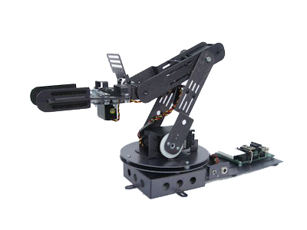
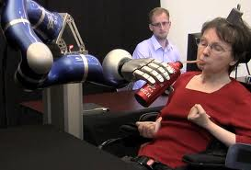
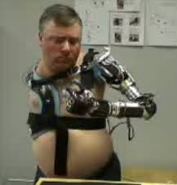
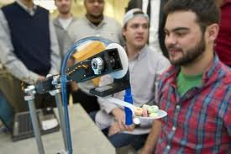
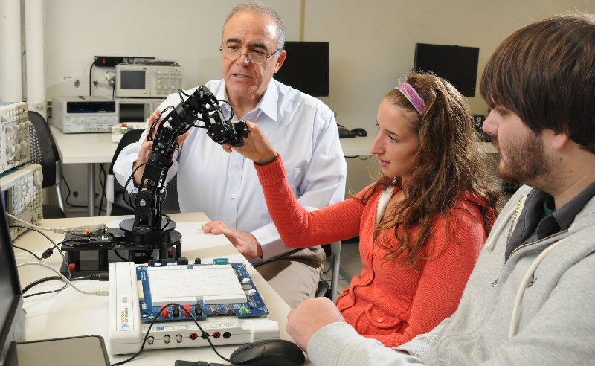
Enabling Robotics

Slide 19
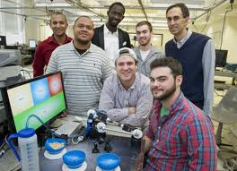
Class Objectives
To introduce ECE students to many of the fundamental concepts in Computer Engineering
To become familiar with Linux and embedded programming
To introduce students to digital design principles
To acquire knowledge of embedded system design
To be exposed to wireless networking and robotic control
To develop an appreciation for the software/hardware interface

Slide 20
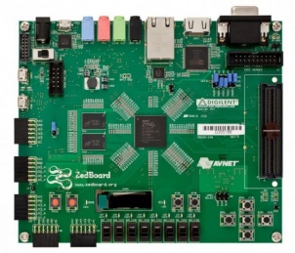
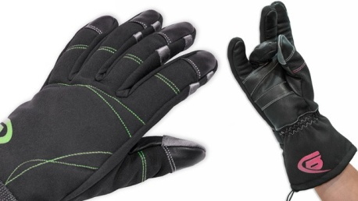
Laboratory - Enabling Robotics
Project Goal: Communicate with an autonomous robotic arm to carry out a set of tasks to help those with physical disabilities
Project 1: Enable the controller board to receive and decode commands from the data glove transmitter
Project 2: Design hardware/software control to serve as the brain of the robotic arm
Project 3 and 4: Develop robot control programs that run on the ZedBoard platform and carry out a set of tasks, in response to the transmitted command
Project 5: Enhance the “brain” to remember past actions to allow for obstruction avoidance

Slide 21
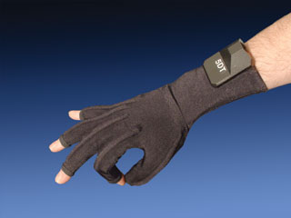
Course – Enabling Robotics
Laboratory Equipment
  Haptic Transmitter
    5DT Data glove
    Cyberglove
  Robot brain
    ZedBoard
      ARM CPU
      Linux
      Xilinx FPGA
  Robotic Arm Kit - many choices
    Crustcrawler Model SG5
    5 HiTec Serv s

Slide 22
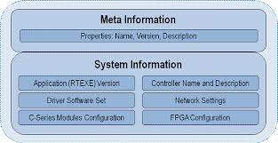
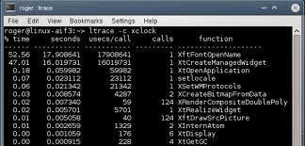
Course – Enabling Robotics
Learning outcomes:
  Students should understand how wireless devices communicate
  Students should understand the basics of combinational and sequential logic design
  Students should have an appreciation for algorithm design
  Students should develop strong skills in C/C++ programming
  Students should gain an appreciation for simulation, debugging and documentation

Slide 23


Course – Enabling Robotics
Curricular coverage:
  C/C++ programming
  Operating systems
  Digital logic fundaments
  Programmable logic
  Simple algorithms
  Simulation
  Wireless communication

