Slide 1
ECE Broad Introductory Courses Teaching Model Discussion
10/25/13

Slide 2
New BS in EE/CE
2 Capstone
Capstone I
Capstone II
EEs take at least 2 EE technical electives
CEs take at least 2 CE technical electives
ECEs take at least 2 CE and 2 EE electives
ECEs take all 6 fundamentals courses
5 General Electives
EE
CE
Other
Numerical Methods and Comp. App.
Micro and Nano-Fabrication
Electrical Machines
Biomedical Optics
Computer and Telecommunication Networks
CAD for Deign and Test
Subsurface Sensing and Imaging
Semiconductor Device Theory
Electric Drives
Biomedical Signal Processing
Embedded System Design
Parallel and Distributed Computing
Antennas
Biomedical Electronics
Power Systems Analysis
Digital Control Systems
Hardware Description Lang. Synthesis
VLSI Design
4 Technical Electives
Microwave Circuits and Networks
Power Electronics
Wireless Personal Communications Systems
Classical Control Systems
High-Speed Digital Design
Networks
Electronic Materials
Electronic Design
Wireless Communications Circuits
Digital Signal Processing
Microprocessor Based Design
Software Engineering I
Optics for Engineers
Electronics II
Communications
Image Processing and Pattern Recognition
Computer Architecture
Optimization Methods
3EE + 1CE or
3CE + 1EE Fundamentals
EE Fundamentals
of Electromagnetics
EE Fundamentals of Electronics
EE Fundamentals
of Linear Systems
CE Fundamentals Dig. Logic Comp. Organization
CE Fundamentals
of Networks
CE Fundamentals
of Engineering Algorithms
2 Broad Introductory Sophomore
ECE Broad Intro. I
Biomedical Circuits and Signals
ECE Broad Intro. II Enabling Robotics
2 Freshman Engineering
Freshman Engineering I
Freshman Engineering II

Slide 3
Instructional Model, Broad Introductory Courses
Professor, 65 minute lecture class
Professor, 65 minute lecture class
Professor, 2 TAs,
1 Undergraduate
140 minute active learning class in the lab

Slide 4
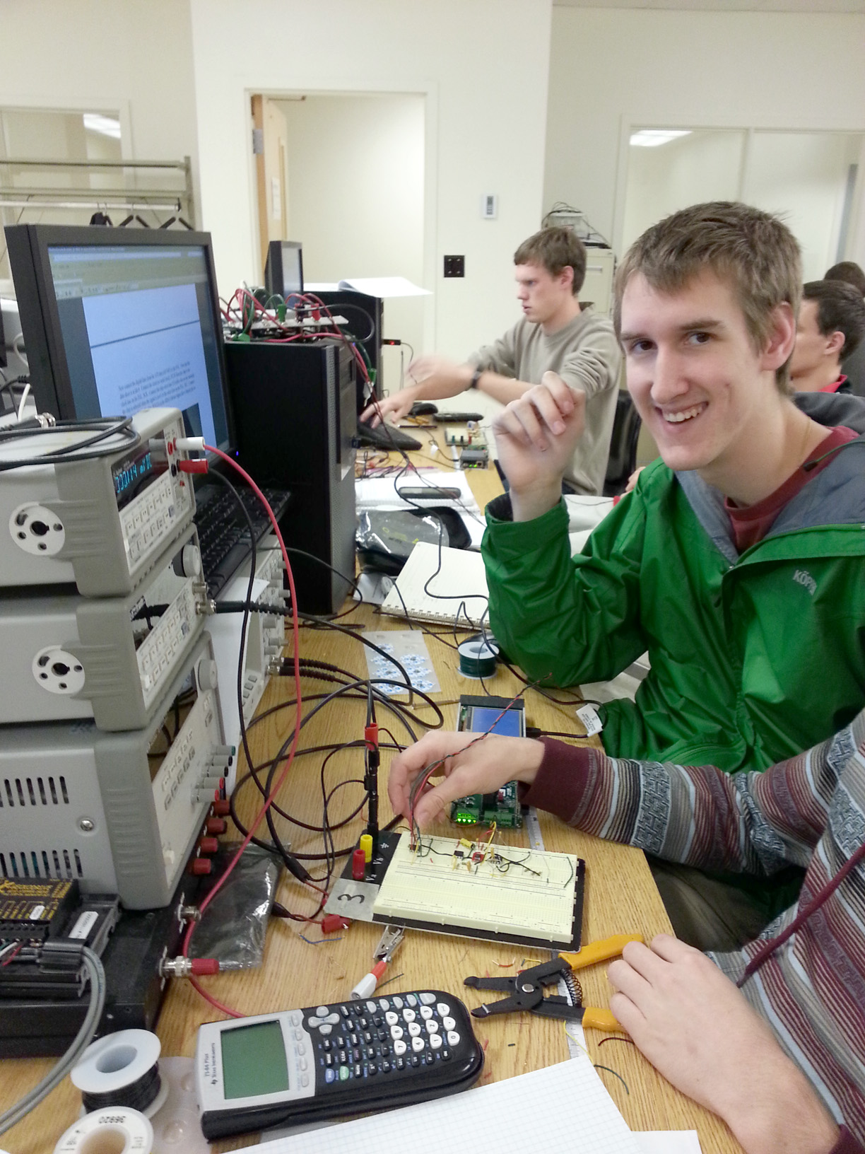
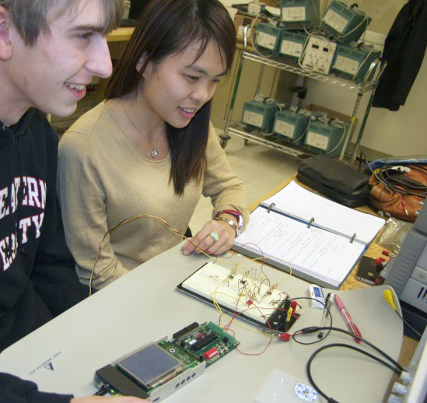
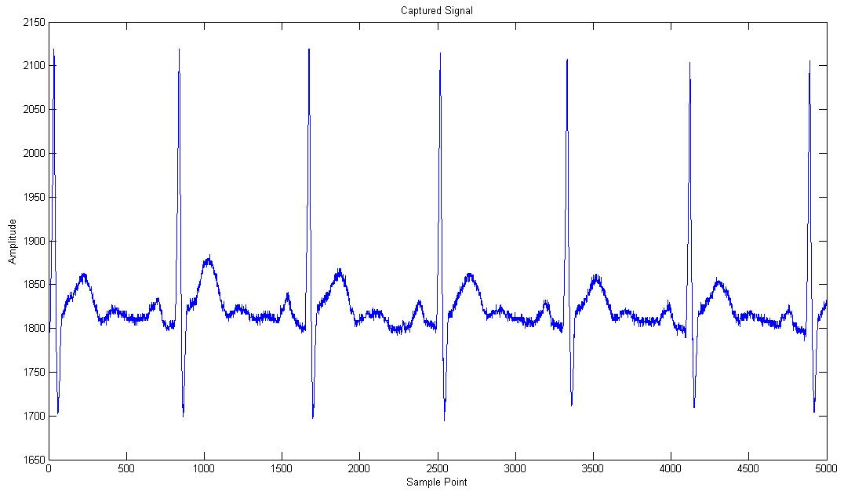
Biomedical Circuits and Signals
Combined Lecture/Laboratory Course

Slide 5
Instructional Model Elements
Make connections with Faculty and Students (retention)
  Sophomore students interact with upper class undergraduates, graduate students and faculty in the active learning portion of the course (the lab).
Coordination
  The students see the same instructors in the whole course (faculty, TAs, upper class undergraduates)
  The lab is tightly integrated with the course
    Lab components discussed in lecture
    Lecture components discussed and used in lab
Work Load
  Faculty - Two 65 minute lectures + One 2 hour active learning (lab) session (with 1 Faculty, 2 TA, 1 UG), 4 credits
  Total # faculty loads less – No separate lab faculty

Slide 6
New BS in EE/CE
Eliminate?
2 Capstone
Capstone I
Capstone II
EEs take at least 2 EE technical electives
CEs take at least 2 CE technical electives
ECEs take at least 2 CE and 2 EE electives
ECEs take all 6 fundamentals courses
5 General Electives
EE
CE
Other
Numerical Methods and Comp. App.
Micro and Nano-Fabrication
Electrical Machines
Biomedical Optics
Computer and Telecommunication Networks
CAD for Deign and Test
Subsurface Sensing and Imaging
Semiconductor Device Theory
Electric Drives
Biomedical Signal Processing
Embedded System Design
Parallel and Distributed Computing
Antennas
Biomedical Electronics
Power Systems Analysis
Digital Control Systems
Hardware Description Lang. Synthesis
VLSI Design
4 Technical Electives
Microwave Circuits and Networks
Power Electronics
Wireless Personal Communications Systems
Classical Control Systems
High-Speed Digital Design
Networks
Electronic Materials
Electronic Design
Wireless Communications Circuits
Digital Signal Processing
Microprocessor Based Design
Software Engineering I
Optics for Engineers
Electronics II
Communications
Image Processing and Pattern Recognition
Computer Architecture
Optimization Methods
3EE + 1CE or
3CE + 1EE Fundamentals
EE Fundamentals
of Electromagnetics
EE Fundamentals of Electronics
EE Fundamentals
of Linear Systems
CE Fundamentals Dig. Logic Comp. Organization
CE Fundamentals
of Networks
CE Fundamentals
of Engineering Algorithms
2 Broad Introductory Sophomore
ECE Broad Intro. I
Biomedical Circuits and Signals
ECE Broad Intro. II Enabling Robotics
2 Freshman Engineering
Freshman Engineering I
Freshman Engineering II

Slide 7
Backup Slides

Slide 8
Instructional Model, Broad Introductory Courses
Section 1, Prof. 1 TA 1,2,3,4
35 Students
Section 2, Prof. 2 TA 1,2 ,3,4
35 Students
Section 3, Prof. 3 TA 1,2,3,4
35 Students
Section 4, Prof. 4 TA 1,2,3,4
35 Students
Note: 2 lectures/week
Lab Class 1
TA 1, 2 Prof. 1
UG 1
Lab Class 2
TA 1, 2 Prof. 2
UG 1, 2
Lab Class 3
TA 2, 3 Prof. 3
UG 3, 4
Lab Class 4
TA 2, 3 Prof. 4
UG 3, 4
Note: 2 hour active learning
Lab Class 1
TA 1, 2 Prof. 1
UG 1
Lab Class 2
TA 1, 2 Prof. 2
UG 2
Lab Class 3
TA 2, 3 Prof. 3
UG 3
Lab Class 4
TA 2, 3 Prof. 4
UG 4
Note that these are taught as 1 class in 2 adjacent rooms
Prof. Office Hours
Summary:
4 Professor-Loads
4 Credits
More consistent set of resources
Could be 2, 3, 4 professors depending on number of students each semester/ teaching loads
Could be 1 TA, 2 UG each
TA 1,2,3,4 Office Hours
HKN Tutors

Slide 9
5-Credit Instructional Models
Current Model (5 Credits)
Proposed Model #1 (5 Credits)
Section 1, Prof. 1, TA 1,2 35 Students
Section 2, Prof. 2, TA 1,2 35 Students
Section 3, Prof. 3, TA 1,2 35 Students
Section 4, Prof. 4, TA 1,2 35 Students
Section 1, Prof. 1, 2, 3, 4 TA 1,2 140 Students
Tues. Morning
Tues. Aft.
Fri. Morning
Fri. Aft.
Tues. Morning
Tues. Aft.
Fri. Morning
Fri. Aft.
ILS 1, TA 1,2, Prof 4
ILS 3, TA 1,2, Prof 4
ILS 5, TA 1,2, Prof 5
ILS 7, TA 1,2, Prof 5
Lab 1, TA 3,4, Prof. 1
UG 1?
Lab 1, TA 3,4, Prof. 2
UG 2?
Lab 1, TA 3,4, Prof. 3
UG 3?
Lab 1, TA 3,4, Prof. 4
UG 4?
Lab 1, TA 3,4, Prof. 4
Lab 3, TA 3,4, Prof. 4
Lab 5, TA 3,4, Prof. 5
Lab 7, TA 3,4, Prof. 5
ILS 2, TA 1,2, Prof. 4
ILS 4, TA 1,2, Prof. 4
ILS 6, TA 1,2, Prof. 5
ILS 8, TA 1,2, Prof. 5
Lab 1, TA 3,4, Prof. 1
UG 1?
Lab 1, TA 3,4, Prof. 2
UG 2?
Lab 1, TA 3,4, Prof. 3
UG 3?
Lab 1, TA 3,4, Prof. 4
UG4 ?
Lab 2, TA 3,4, Prof. 4
Lab 4, TA 3,4, Prof. 4
Lab 6, TA 3,4, Prof. 5
Lab 8, TA 3,4, Prof. 5
Prof. Office Hours
Summary:
6 Professor-Loads
5 Credits 4/1
Lecture/ILS/Lab/Grading/Tutor coordination is a problem
Students don’t know where to turn
Prof. Office Hours
Summary:
4 Professor-Loads
5 Credits 4/1
More consistent set of resources
Could be 2, 3, or 4 professors depending on teaching loads
TA 1,2 Office Hours
TA 1,2 Office Hours
Circuits Tutors
HKN Tutors
HKN Tutors

Slide 10
New Curricular Structure, BSEE and BSCE
Capstone
CE Tech. Electives
General Electives
ECE Broad Intro.
+ EE or CE core.
Freshman Eng.
Science
Math
Arts, Hum., S.S.
Writing
31 four-credit courses + 8 (CE) or 9 (EE) one-credit extras = 132 or 133 credits

Slide 11
Current Curricular Structure, BSCE
Capstone
CE Tech. Electives
General Electives
CE Core
Freshman Eng.
Science
Math
Arts, Hum., S.S.
Writing
32 four-credit courses + 10 one-credit extras = 138 credits

Slide 12
Broad Introductory Sophomore Courses
Provide early, integrated courses with labs
  Motivate students
  Make connections within ECE
    ECE Technical Topics
    With ECE Faculty and Students (sophomore retention)
  Help students choose area of study
  Improve coop preparation
Provide breadth to the EE and CE curricula

Slide 13
Best Practices
Active Learning
  Integrate lab elements with courses
Introduce the “essence of engineering” early
  Move traditional labs toward design/discovery
Presidents Council of Advisors on Science and Techlology (PCAST): Engage to Excel (2012)
Discipline-Based Education Research: Understanding and Improving Learning in Undergraduate Science and Engineering, National Research Council, (2012)
National Acadamey of Engineering Reports, Educating the Engineer of 2020: Adapting Engineering Education to the New Century (2005)
Transformation Is Possible If a University Really Cares. Science, April 19, 2013

Slide 14
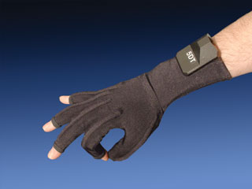
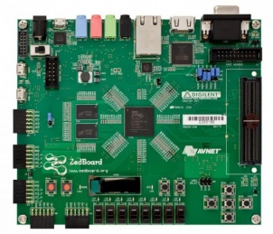
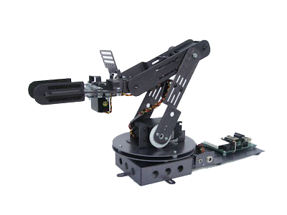
Course – Enabling Robotics
Laboratory Equipment
  Haptic Transmitter
    5DT Data glove
    Cyberglove
  Robot brain
    ZedBoard
      ARM CPU
      Linux
      Xilinx FPGA
  Robotic Arm Kit - many choices
    Crustcrawler Model SG5
    5 HiTec Serv s

Slide 15
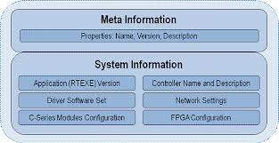
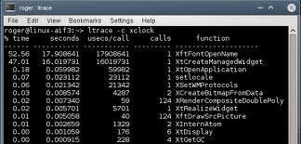
Course – Enabling Robotics
Learning outcomes:
  Students should understand how wireless devices communicate
  Students should understand the basics of combinational and sequential logic design
  Students should have an appreciation for algorithm design
  Students should develop strong skills in C/C++ programming
  Students should gain an appreciation for simulation, debugging and documentation

Slide 16
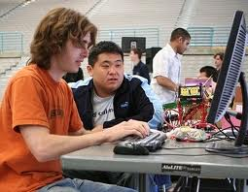

Course – Enabling Robotics
Curricular coverage:
  C/C++ programming
  Operating systems
  Digital logic fundaments
  Programmable logic
  Simple algorithms
  Simulation
  Wireless communication

Slide 17
Circuits and Signals: Biomedical Applications
Combined Lecture/Laboratory Course
Covers a little more than half of circuits (some signals material is covered in circuits)
  R, L, C, sources, Kirchhoff’s Laws
  Thevenin and Norton equivalent circuits
  Op-Amp Circuits
  Phasor Analysis, Filters, Transfer Function
Covers Portions of Linear Systems
  LTI Systems
  CT and DT Fourier Transform
  Transfer Functions and Filters
  ADC
Biological Component (2 classes)

